Slide 1
Data Science Today Amidst Disruptive Technologies

Slide 2






Challenges turning Big Data Analytics into Competitive Advantage
Funny as how these challenges existed over 25 years ago
Lack of clear roadmap
Getting corporate alignment and C-suite buy-in
Lack of appropriate data structures
Difficulties finding insights
Difficulty proving the business case/undisciplined reporting and measurement
Uncertainty as to how to convert insights to action

Slide 3



‘Small’ Data… there’s still big work to be done here
Analytics 1.0
(descriptive)
Analytics 2.0
(predictive)
Analytics 3.0
(prescriptive)
One view of the customer
Alignment and culture
Many organizations that do have Big Data (needs, problems) still have a lot of work to do to achieve analytics capabilities with their ‘small data’.
But what does this really mean?
Notes:
- Business has a pretty good handle on reporting what has happened
- Some organizations are getting very good at predictive analytics, but others have only just begun
- Very few are at the point of having ‘next best action’ capability across their organization
- OneView of the Customer is more challenging than it sounds… a single piece of software won’t get you there (despite vendor claims).
- Relatively few organizations have aligned on data-driven decision-making as its strategy/culture.

Slide 4
Analytics as an Ongoing Journey
Continuous Improvement Through Data Analytics
Analyze
Plan
Execute
Evaluate
Insights
InInvestment Strategies
Creative and Media
Measure
Opportunities
Customer Contact & Communication Strategies
In-Market Testing
Learn
Optimize

Slide 5

Data Discovery Process Overview
Business discovery & alignment
Data audit
Analytical snapshot
Insights and recommendations
Analytical roadmap
Customer strategy
Data strategy
Tactical opportunities

Slide 6
The Four Step Process in building Analytics Solutions
A 4 stage discipline that requires STRUCTURE and PROCESS
Problem Identification
Application of the Data Mining Tools
Implementation and Tracking
Creation of the Analytical Data Environment
Yet elements
within the
process are
different
The overall process
remains the same

Slide 7
The Data Science Tasks within the Process?
Identification of Business Problem
Creation of the Analytical File
Development / Validation of a Predictive Analytics Solution
Deployment and Measurement of the Solution
Feature engineering
  Correlation
  Factor analysis
  Decision tree
  EDA reports
Modelling routines
  Regression
  Neural nets
  Ensemble, etc.
Validation
  Decile charts, gains charts
  AUC curves
Meet with key stakeholders
Understand business issues
Understand available data
Review relevant documentation
Define data audit requirements
Operationalization of solution
  Real-time vs. batch
Creating the measurement framework
Analyzing model performance and key learning
Audit existing data
Assess completeness and accuracy of data collected
Produce initial frequency reports
Identify data gaps/recommend third party data overlays
Variable creation
© 2016 Environics Analytics
Notes:
Discovery – understanding the available data has become a more significant step (not just customer, product, transaction anymore).
Creation of the analytical file can now involve much more preparation (although the data scientist may not be directly responsible for this, he/she may direct it).

Slide 8
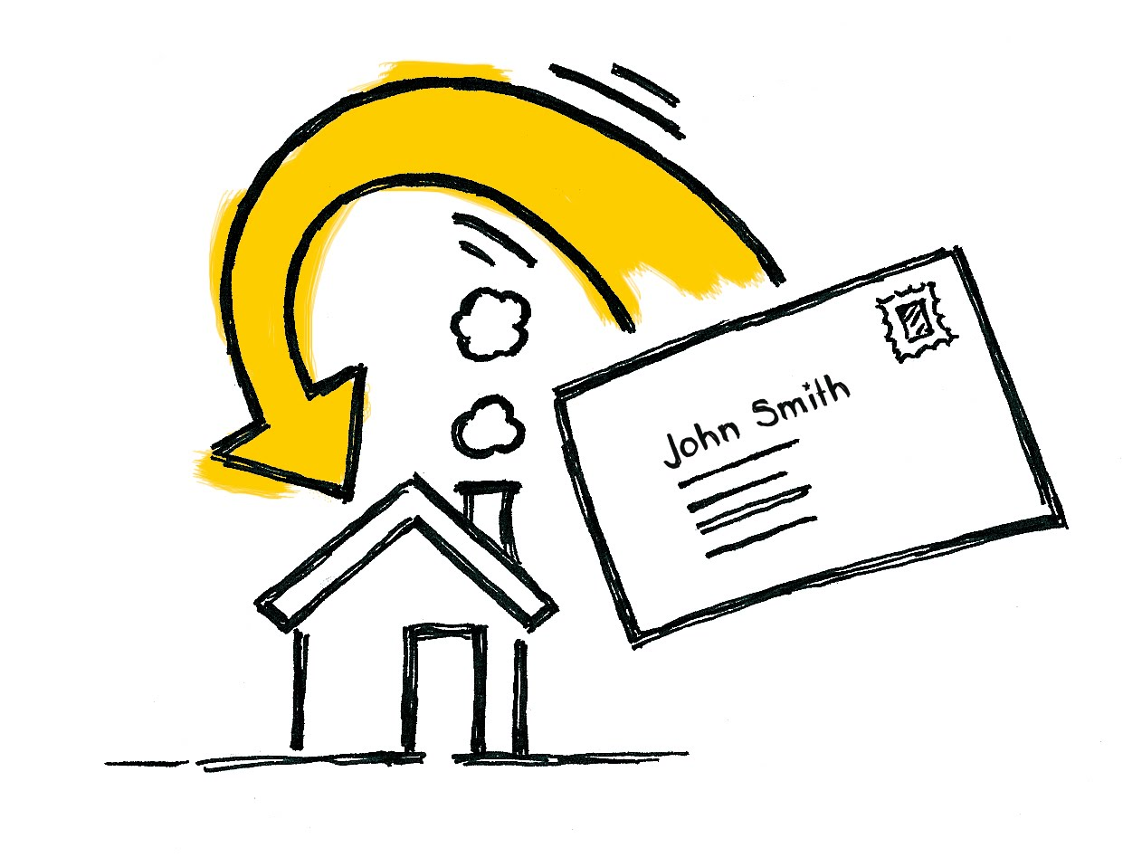
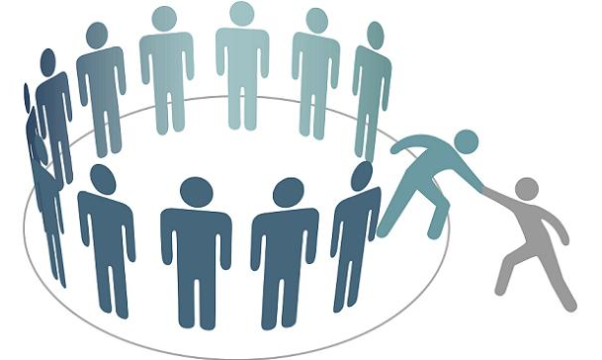


Some Current Applications of Analytics
Retention/acquisition
Direct Marketing
Prioritizing channel opportunity
Call Center Operations
Fraud Detection
Risk Management
Quality Control

Slide 9
What do the Current Roles and Responsabilities Look Like?
Data Managers – need to manage new containers, flows, governance, delivering on expectations
Analytics Practitioners – need to harness new types of data and integrate them into their processes (determine the veracity and potential added value)
Business Strategists – need to understand and evaluate the potential that new types of data and capabilities have and how to leverage this to deliver value to the organization
© 2016 Environics Analytics
Notes:
Depending on your role, this will have different impacts for you.

Slide 10

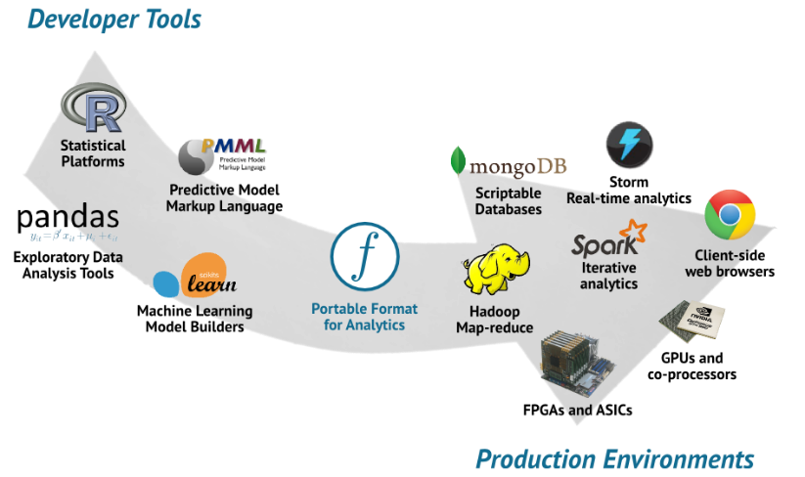

What are these disruptions?
Big Data
Increased Automation of Tools
Artificial Intelligence

Slide 11
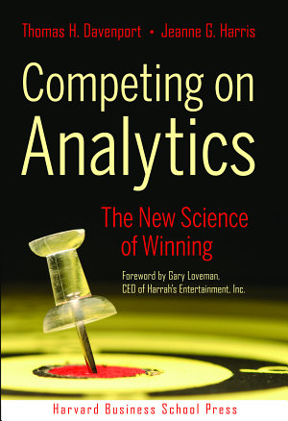
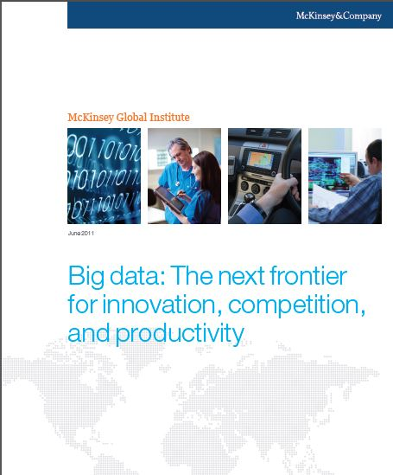
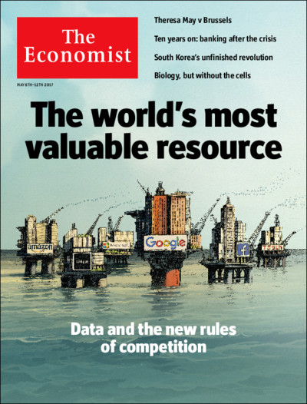
Big Data
Lots of books, white papers and press
2006
2011
2017

Slide 12
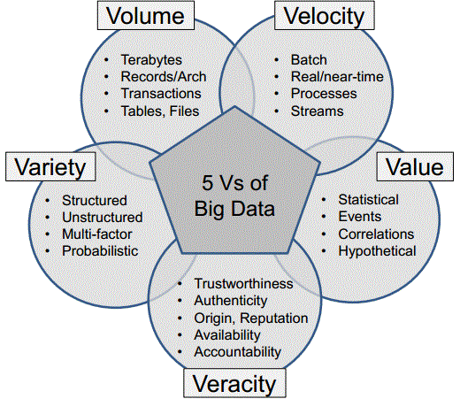
Big Data
What does this really mean for
predictive analytics practitioners?
MORE DATA

Slide 13
Big Data :Hype to productivity (early maturity)
Big Data had been a fixture on the Gartner Hype Cycle for Emerging Technologies for several years
in 2015, Gartner eliminated the ‘Big Data’ Hype Cycle because it felt that Big Data had moved past hype and into practice.
2013
2012
2014
2011
2015
Innovation Trigger
Peak of Inflated
Expectations
Trough of
Disillusionment
Slope of
Enlightenment
Plateau of Productivity
Source: Gartner, Hype Cycle for Business Intelligence and Analytics 2015
Notes:
- At the peak of hype/expectations, adoption is quite low.
- As the hype fades, adoption actually begins to increase.
- Not all technologies get past the Trough of Disillusionment. Those that do survive and reach the Plateau of Productivity get to 20-30% adoption and beyond.
- “Hype Cycles consider any adoption trend that goes beyond 20% of the wider IT market to be past hype and entering into early market definition.”

Slide 14
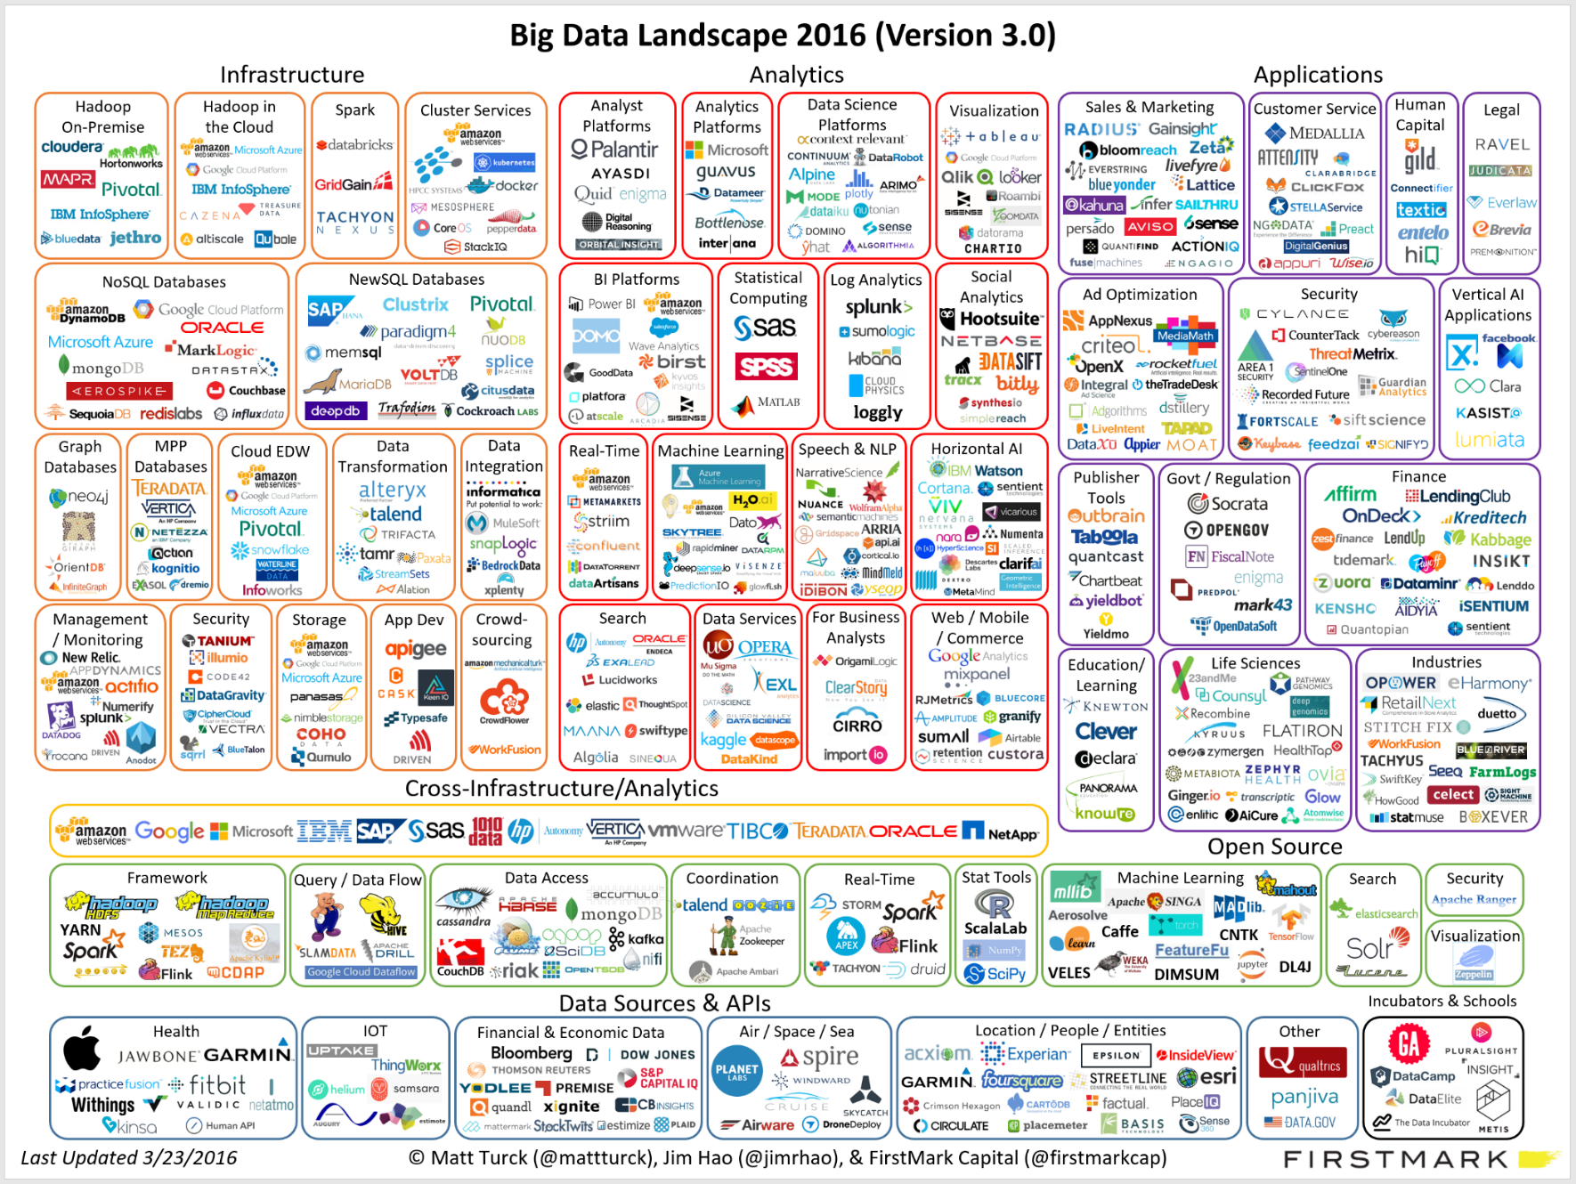
Big Data: some of the Vendors?
Notes:
Some software vendors will claim to be able to solve all your analytics needs. This is VERY unlikely.
Whether hype or not, and whether you like the term Big Data or not, there are over 600 companies that are invested in this ecosystem.

Slide 15
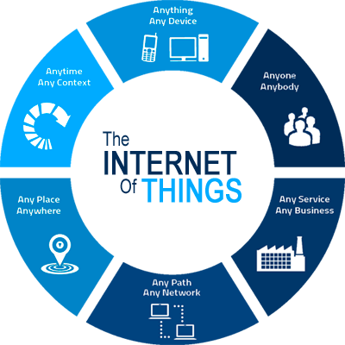

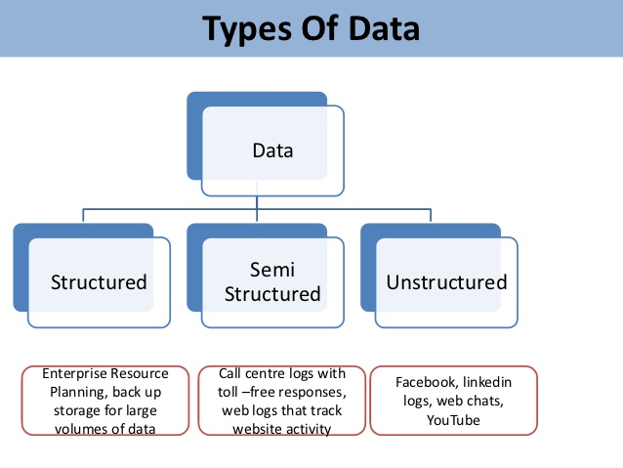
Big Data
What is new to the data scientist?
  Newer ETL skills
  Ability to work with all kinds
  of data

Slide 16
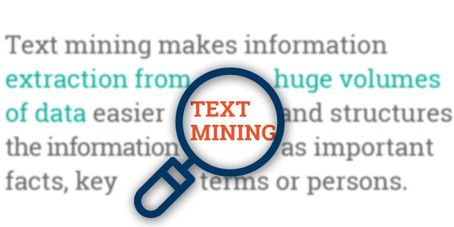
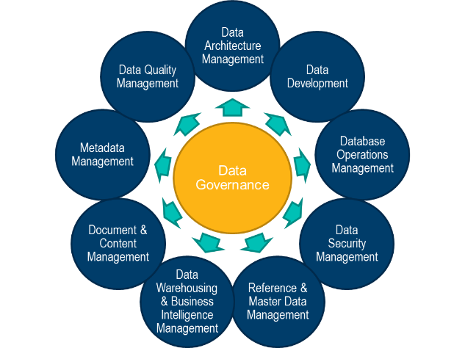
Big Data
Increased Demand for Text Mining
Need for more robust platforms that operate in cloud
Increased Data Governance is a consequence of Big Data

Slide 17
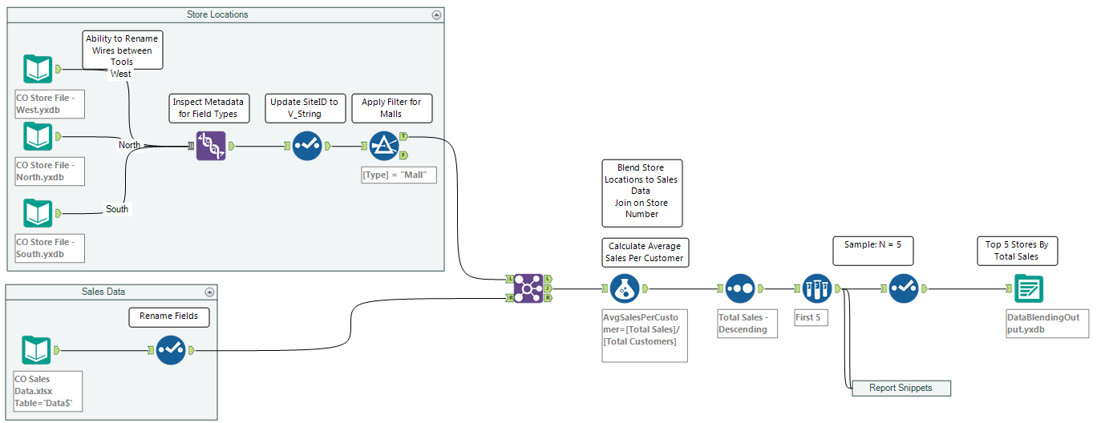
Increased Automation of Tools
Creating the analytical file is no longer the monopoly of programmers in R, Python or SAS.
Data scientists need to understand data and the relevant processes in creating the analytical file but not necessarily programming code or syntax.
Sample of data process
flow used to create
analytical file in
determining top 5
stores

Slide 18
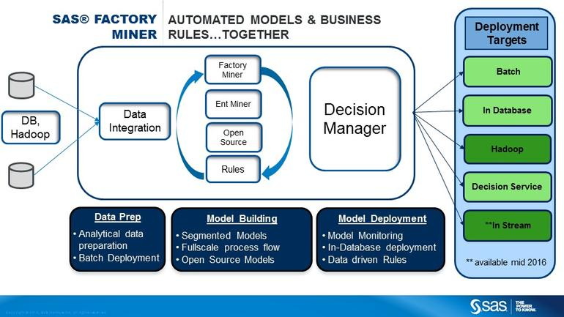
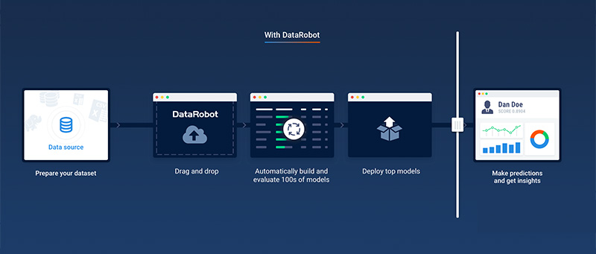
Increased Automation of tools
Machine learning software and tools can now generate multiple models in matter of seconds i.e. can we envision a “Ford” type model factory

Slide 19

But what about AI and machine learning?
Picture credit: Medical Futurist
Notes:
How does it differ than machine learning ?
Fundamentally AI uses neural net technologies
How does it differ than machine learning ?
So why the hype now on AI and neural nets?
Picture credit: http://medicalfuturist.com/10-things-how-artificial-intelligence-could-make-me-a-better-doctor/

Slide 20
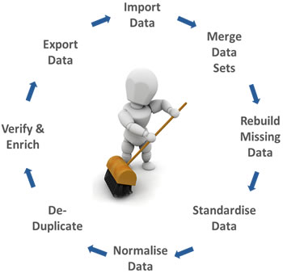

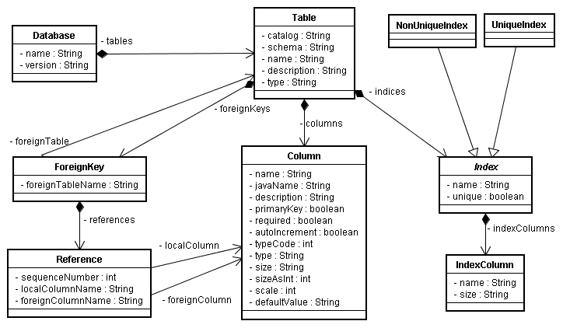
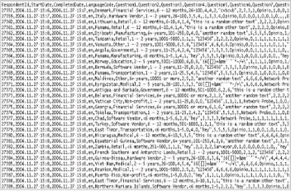
Machine learning
Some debate on the exact definition but essentially the process of a machine that can make decisions without human intervention.
The Data Science process is still the same. See below.
RAW DATA
Data cleansing
Feature engineering
Model building
Notes:
Most AI work in Image recognition,breakthroughs by Geoffrey Hinton-U of T and Youssef Beggio-U of M,etc. Much of the more R&D work in feature engineering is being done on images-applications-insurance claims-health –transportation-think of others

Slide 21
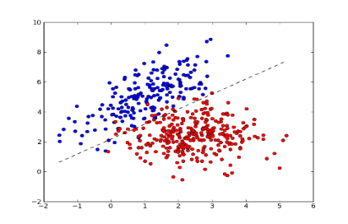
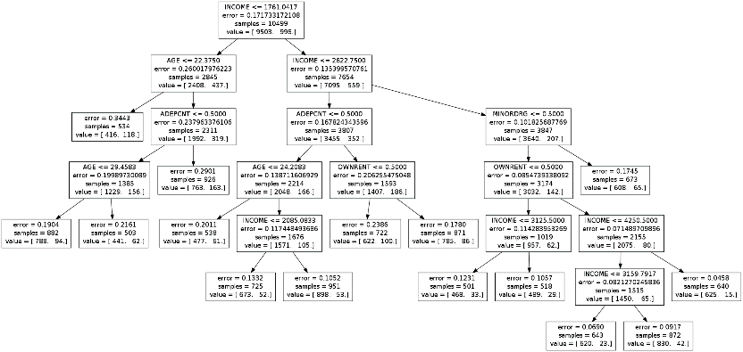
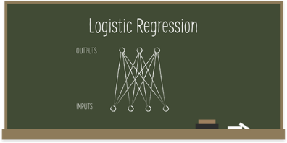
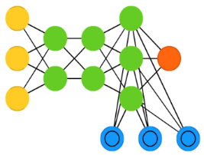
Machine learning and artificial intelligence
Linear/logistic regression
Svm/discriminate analysis
Decision trees
NEURAL NETS
ARE THEY ALL FORMS OF MACHINE LEARNING ?
Neural net techniques represent the underpinnings of AI ?
Notes:
An iterative process
When the computer is learning, there is an iteration going on.

Slide 22
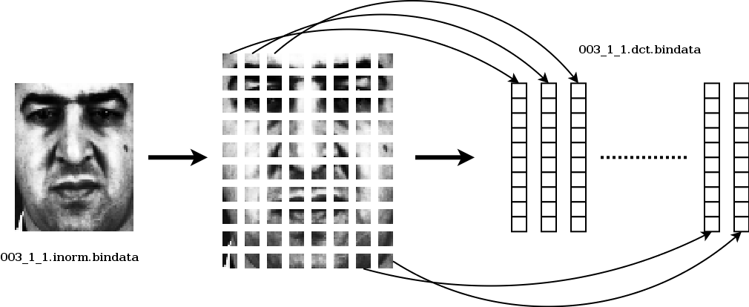
Image recognition has been the most commonly used AI Application
The concept of the pixel and trying to predict pixels within a picture
Business applications could include insurance claim processing, property management claims and others
Notes:
Basic concept-more pixels-more image definition-better prediction-more accurate prediction of more pixels

Slide 23
AI and Natural language processing
Uses AI to generate text based on historical text
Utilizes recurrent neural net methodology unlike image recognition which uses convolutional neural net methodology.
Many application today:
  Speech recognition(Echo,Siri)
  Analysis of historical documentation
    Medical Diagnoses
    Review of Legal cases and precedents

Slide 24
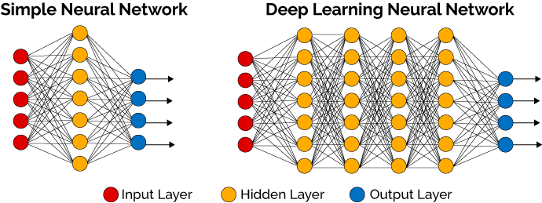
But why is AI now a game changer
Two keys to success:-
  Extremely large volumes of data
  Large signal to noise ratio

Slide 25
Does it work in predicting consumer behaviour
Our R&D work in most applications to date where the signal to noise ratio is very low yields the following result:
No increased performance due to AI(neural nets) as seen by
same model evaluation as determined by rank ordering of response
rate across model deciles

Slide 26
Does it work in predicting consumer behaviour
Our R&D work in applications where the signal to noise ratio is somewhat stronger and against a large volume of records:
Going from a traditional regression model to a neural
net with a single hidden layer and with over a million
records
Going from a neural net with a single hidden layer to a
neural net with three hidden layers and over a million
records
We now observe that model
performance increases through the
use of neural nets and even as we add
more complexity

Slide 27
Data Discovery Example
Entertainment Case

Slide 28
Data Discovery -Migration Example
 | Current Year Activity
Value Segment in Previous Yr. | Growth | Stable | Decline | Inactive | Total
Premiere | --- | 41% | 53% | 7% | 18,406
High | 8% | 23% | 44% | 24% | 36,811
Medium | 9% | 21% | 14% | 56% | 73,620
Low | 14% | 11% | --- | 75% | 55,215
Total | 9% | 20% | 20% | 50% | 184,052
60% of Premiere members are in decline or inactive – a concerning trend that should be addressed with new marketing initiatives to re-engage these members

Slide 29
Data discovery Sample Example of Potential Decision Matrix
  Sample Roadmap of Marketing Opportunities
  Opportunity to prioritize activities based on $ opportunity
Segment | # Customers | Avg. Value | Strategy | Projected RR | $ Growth Potential | Segment Potential
New | 54,752 | $80.40 | Dedicated Welcome & Onboarding | 15.00% | 40% | $264,123.65
Premiere in Decline | 9,755 | $623.53 | Retention | 5.00% | 20% | $60,825.35
Potential Premiere | 22,086 | $147.08 | Up-sell | 10.00% | 30% | $97,452.27
Underdeveloped Concession | 15,203 | $248.00 | Cross-sell | 2.50% | 15% | $14,138.79
Etc….

Slide 30
Is Big Data always the answer
Telematics Example

Slide 31
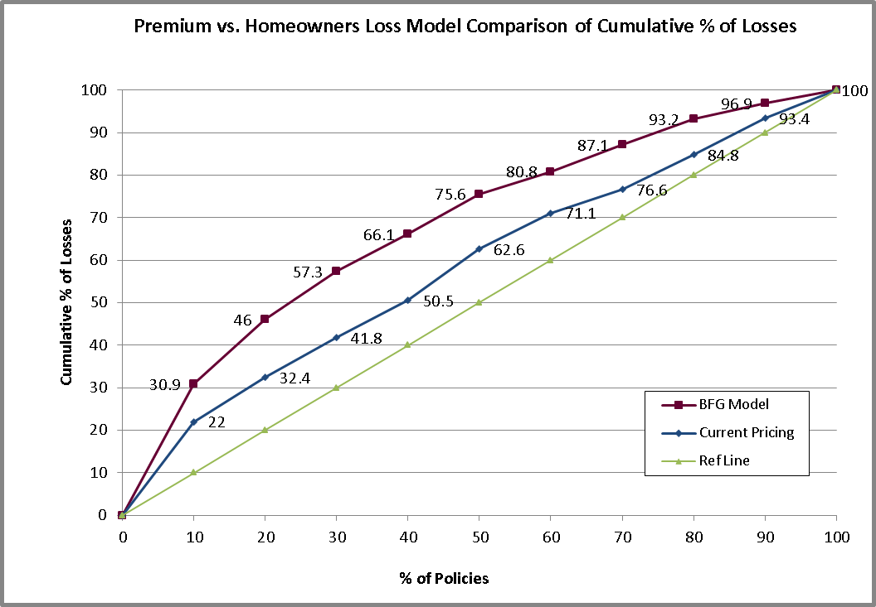
P&C INSURANCE MODEL – USING TELEMATICS DATA?
Premium vs. Auto Loss Model Comparison of Cumulative % of Losses
This predictive model did NOT use telematics data. It is already a very good model. If telematics data is available, should it be used? Consider…
only ~25% of policyholder base has installed sensor in their car
this is a biased sample – sensors are typically installed by those with conservative driving behaviour
Can we significantly increase the lift shown in this table with telematics data?
EA Model
© 2016 Environics Analytics
Notes:
JUST BECAUSE THESE NEW SOURCES OF DATA ARE AVAILABLE, DOESN’T MEAN THEY WILL ADD VALUE FOR OUR PURPOSE.
THE BUSINESS MIGHT HAVE THIS TYPE OF DATA AND DATA SCIENTISTS WILL HAVE A NATURAL CURIOSITY TO EXPLORE THIS DATA FOR POTENTIAL INSIGHTS. However, consider objective of this initiative… predicting loss costs (loss vs. premium) for auto insurance. value proposition

Slide 32
Mobile Data

Slide 33
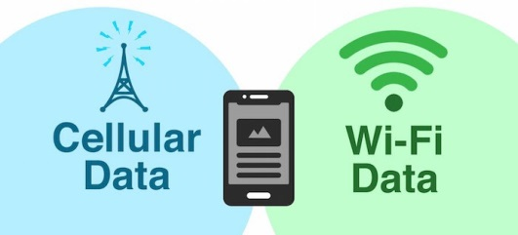
Using Mobile/Sensor Data at the Customer Level
OBJECTIVE:
Can we identify and increase customer retention for a given restaurant chain?
CHALLENGE
SOLUTION
THE NEW CHALLENGE
No customer level information
Handling sensor data
Use mobile device to identify customer (MACID) and develop retention model based on MACID

Slide 34
Using Mobile/Sensor Data at the Customer Level
KEY: CREATION OF THE RIGHT ANALYTICAL FILE
100+ derived variables created based on:
Store information
Strength of signal
Time
Changes
Creating the target variable of defection
  All customers had some activity in first three months
  Defectors were defined as having no activity in fourth month

Slide 35
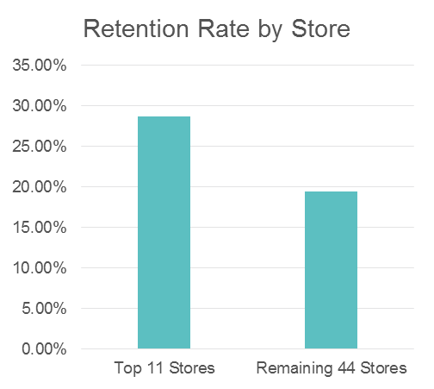
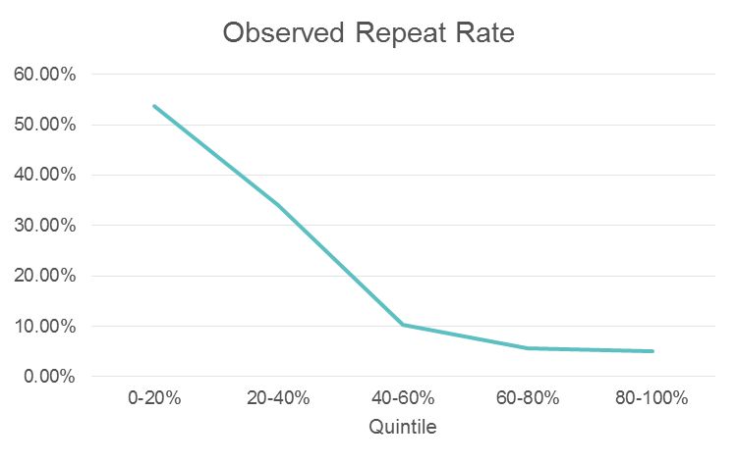
Using Mobile/Sensor Data at the Customer Level
Store Data Analysis
Model Validation
Results indicate that model is performing very well in identifying repeat visitors
Best Visitor Program for top 20% of customers
Stimulation/reactivation for bottom 40%
Top 20% of stores have 28.67% Cx Retention
Identify the characteristics of high performing stores and replicate to lower performing stores
Two deliverables were:
Development of predict model on likelihood to visit
Use of predictive model to develop store strategies

Slide 36
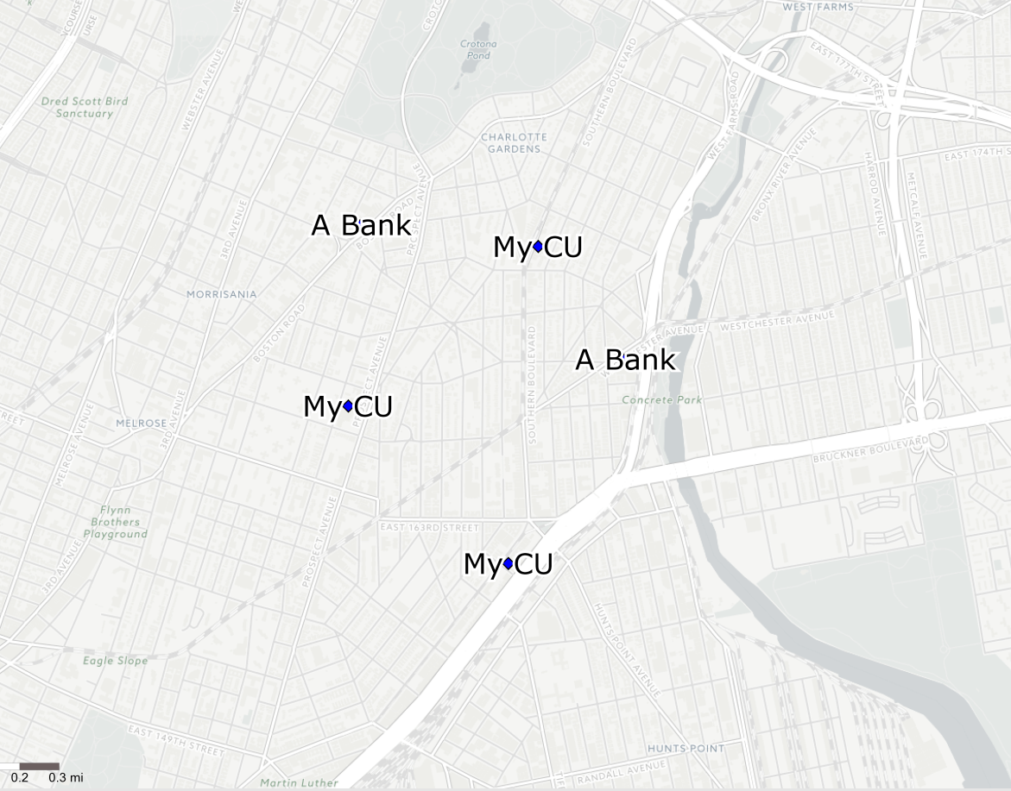
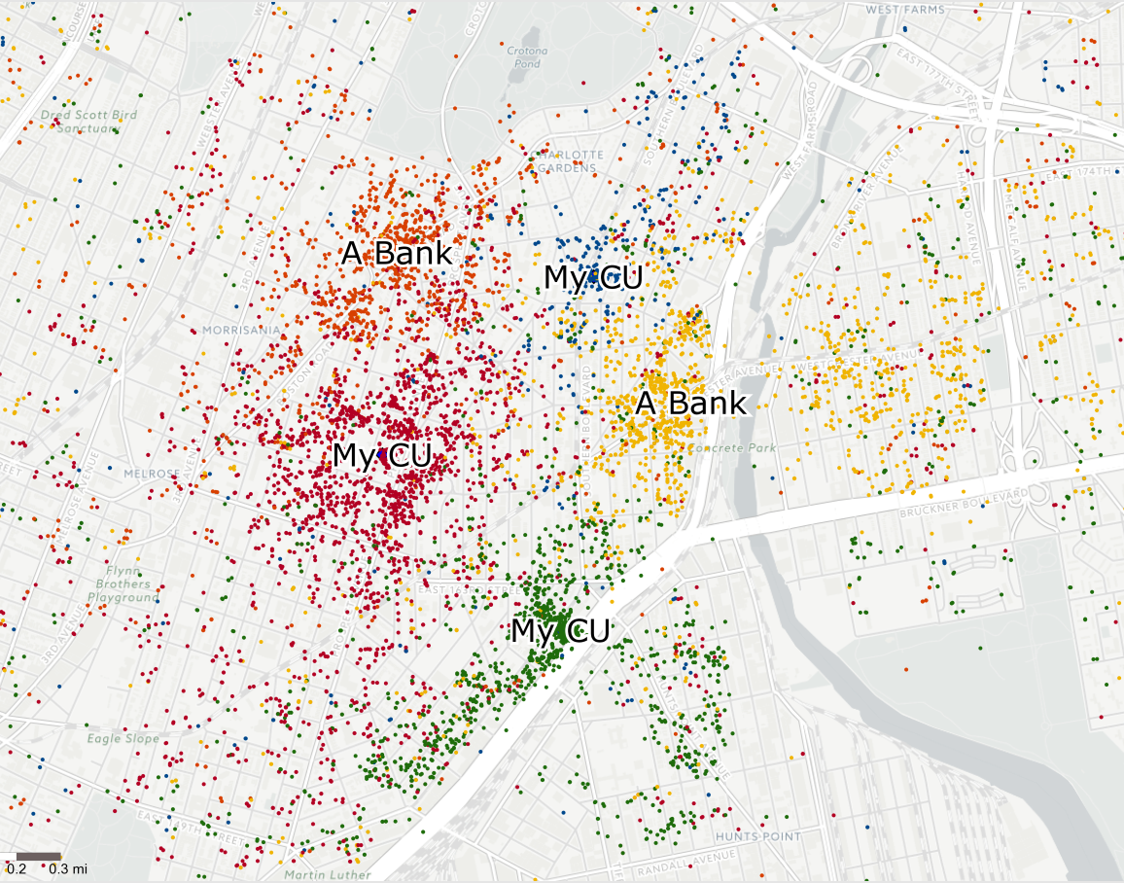
Site Level Mobile Data-Competitive Visitors
Your locations versus your competitive locations
Using Mobile data to develop location strategies around stores/
sites

Slide 37
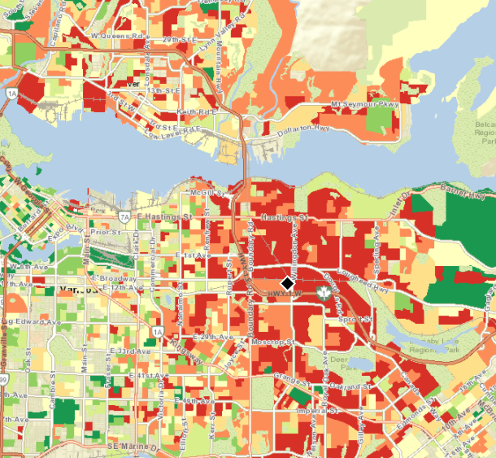








Site Level Mobile data-Profile Analysis by Visit Performance
Mixed Site Visit Performance
High Site Visit Performance
Low Site Visit Performance
Development of analytical visitor profiles around different
locations

Slide 38
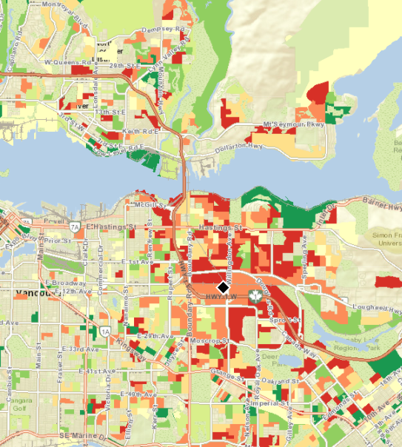
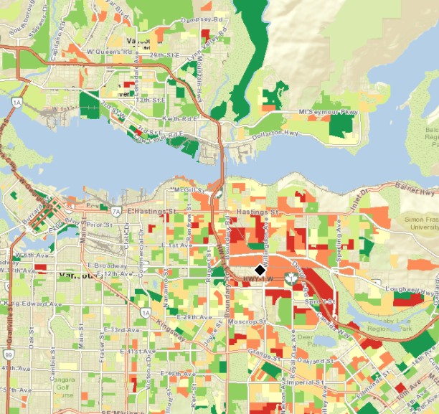
Site Level Mobile Data-Time of Day Analysis
See how your visitor profiles change over the course of the day
All Trips
Early morning
midday

Slide 39








So what is the future of the Data Scientist?
What’s the problem here?
“Build me a model”
“Let me get at the data”
Business User
Data scientist

Slide 40
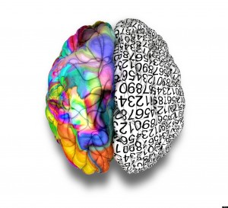
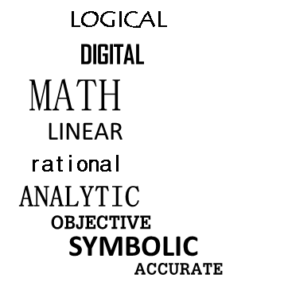
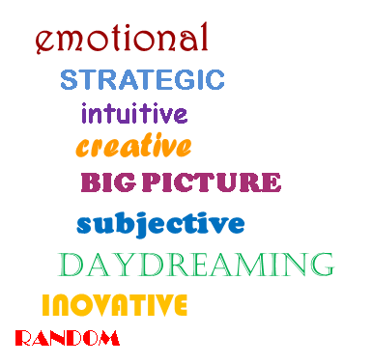
So What is the Future of the Data Scientist?
This divide or disconnect is the real challenge in analytics
  But why does it exist?
  The two functions:
Data Scientist
(Left Brain)
X Business User
(Right Brain)
Physiologically, there is a barrier in adopting a more collaborative approach

Slide 41






So What is the Future of the Data Scientist?
Hybrid Growth is the Key to success
“Build me a model”
SUCCESS
Citizen Data Scientist

Slide 42

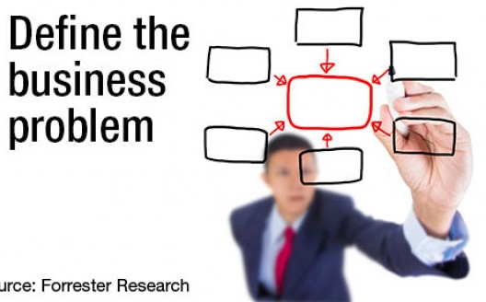
Final Thoughts
1
BIG DATA
2
BIG DATA
3
ULTIMATELY, CONSIDER HOW TO:
PANACEA FOR ALL PROJECTS
USE JUDICIOUSLY
GOAL:
Create the right analytical data set for the business problem

Slide 43
My Book
'Boire provides a straightforward and disciplined overview of the practice of data mining. Whether you are dealing with large or small data sets, tomorrow's business leaders will be the ones that extract the most value from their customer information. Boire leverages his extensive experience as a practitioner to help the reader take a measured approach while providing a unique view of data mining.‘
- Bryan Pearson, President and Chief Executive Officer, LoyaltyOne
'Terms like 'analytics,' 'data mining,' and 'modeling' evoke fear in the heart of many a traditional marketer. Instead of focusing solely on techniques, Boire organizes his content around types of management decisions. In the process, he demystifies and explains the rationale and methods used in terms that anyone can understand. A must read for those getting started or looking to round out their expertise.‘
- Kenneth B. Wong, Distinguished Professor of Marketing, Queens University, School of Business
'Business managers and decision makers have been in need of a book on data mining, and—voila! This industry overview is unique in serving the needs of the consummate businessperson, differentiating it from the many introductions for would-be hands-on, technical practitioners. Boire has formed a conceptually rich and insightful compendium that delivers a pragmatic perspective on both the tactical and strategic value of data mining and predictive analytics.'
- Eric Siegel, founder of Predictive Analytics World and author of Predictive Analytics: The Power to Predict Who Will Click, Buy, Lie, or Die

